Slide 1
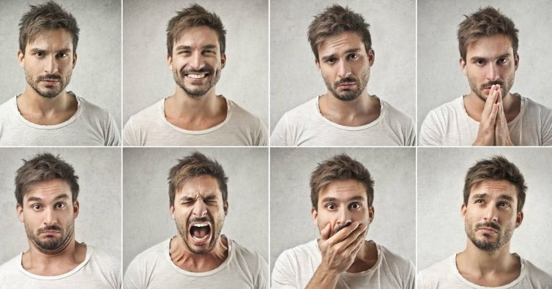
Development of ML models to predict client emotions based on facial expressions and audio input in various online meeting platforms.
Group Members
Harsh Trivedi - 0788765
Kunal Ghaware - 0769182
Panav Jadhav - 0774109
Kavita Virk - 0787818

Slide 2


Slide 3
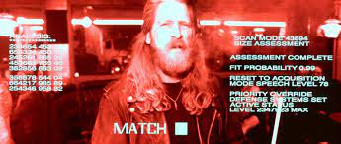

Slide 4
Introduction
Reasons that motivated us for doing this study
New Field of exploration.
Solving Real-World Problem.
What was the problem
Therapist should get an overview of the session that they had with the client and verify weather or not they are reading the clients emotions correctly.

Slide 5
Background
Existing audio and video model (Alpha Model).
VGG16 for Video Emotion Classification Model.
Training Accuracy – 94.45%
Test Accuracy – 82.61%
Dataset size – 7254 images (JPEG)
LSTM for Audio Emotion Classification Model.
Training Accuracy – 96.62%
Test Accuracy – 76.82%
Dataset size – 2446 audio files (WAV)
Web Application

Slide 6
Research Objectives
Predicting emotions of the client from facial expressions and speech input.
Deploy the model on the Web Page of an existing website using API to support end to end analysis.

Slide 7
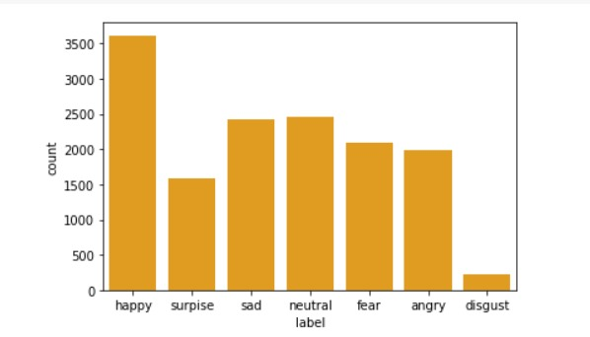
Data Description
FER – 2013 (Kaggle)
48 x 48 pixel images
14236 training images
7632 testing images
Grayscale images
Dataset is already divided into 7 categories.
Angry
Disgust
Fear
Happy
Sad
Surprise
Neutral

Slide 8
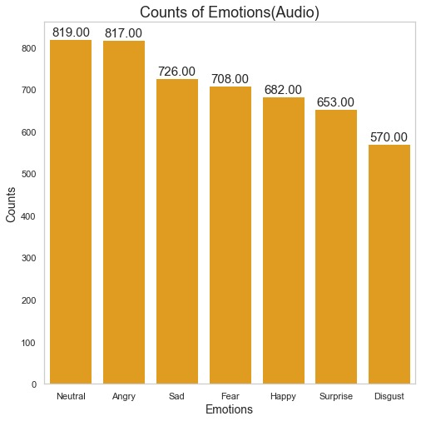
Data Description
Multilingual Dataset (English, Arabic, Urdu, Italian, German)
WAV Format
3976 training audio files
996 training audio files
Dataset is already divided into 7 categories.
Angry
Disgust
Fear
Happy
Sad
Pleasant Surprise
Neutral

Slide 9
Data Description
Image dataset is Imbalanced
Images are consistent
Audio data is evenly distributed and well balance
Audio data is inconsistent
FER Dataset
Multilingual Dataset
Train
Test
Train
Test
14,240
7,178
2240
560

Slide 10
Methods
Analyzing and studying the alpha version model and results
Deploying the model API on the WebPage
Finding out scope of improvement of the model finalized in alpha version
Creating API to deploy the trained models on the website
Gathering dataset required for training our model
Saving the models that we have trained
Running different models to see which model fits the best for our problem statement
Finalizing the best model that meets our problem statement

Slide 11
Results
Models tested for Video – MobileNet, VGG16, AlexNet, CNN
Model tested for Audio – LSTM and CNN
Models tested | Accuracy
MobileNet | 96.16
AlexNet | 82.12
VGG16 | 92.67
CNN | 48.54
Models tested | Accuracy
LSTM | 97.96
CNN | 84.43

Slide 12
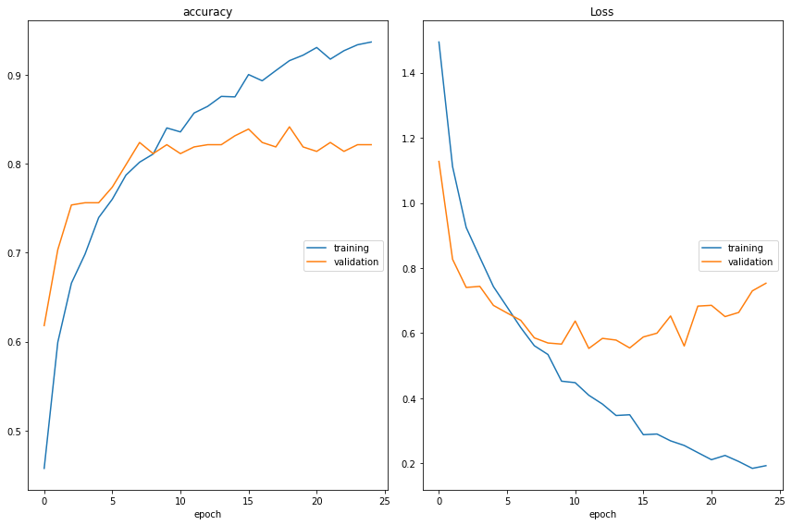
Results
Accuracy – 98.52%
Precision – 95.23%
Recall – 94.37%
F1 Score – 93.92%
AUC – 99.08%
Loss – 22.21%

Slide 13
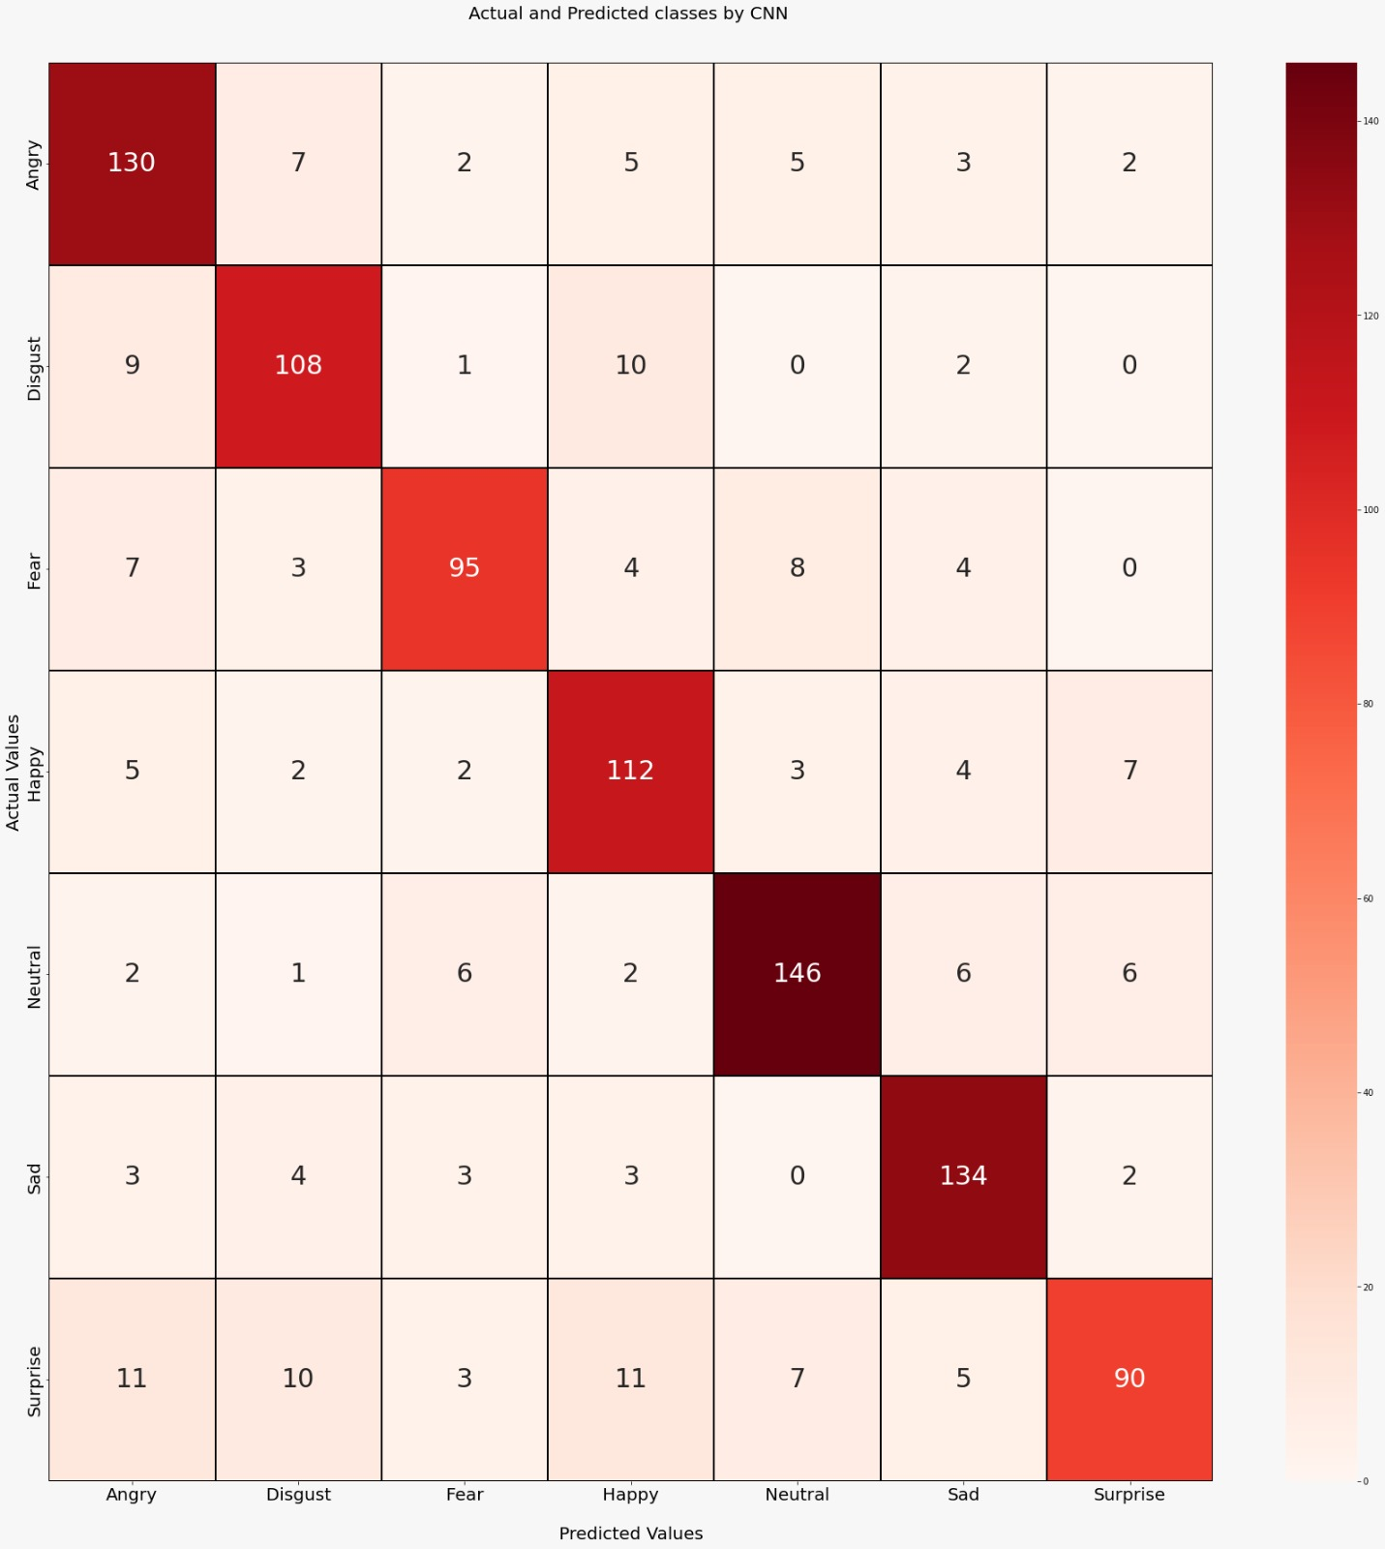
Results (Audio Model)

Slide 14
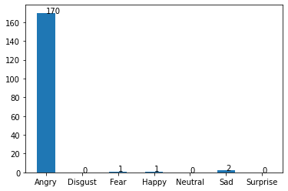
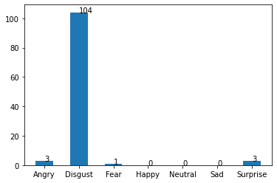
Sensitivity of the audio model
Sensitivity of the audio model w.r.t. Angry Emotion
Sensitivity of the audio model w.r.t. Disgust Emotion

Slide 15
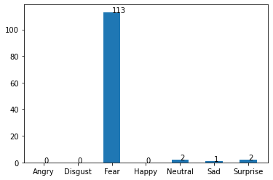
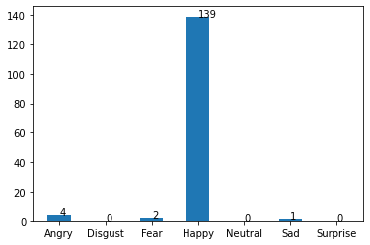
Sensitivity of the audio model
Sensitivity of the audio model w.r.t. Fear Emotion
Sensitivity of the audio model w.r.t. Happy Emotion

Slide 16
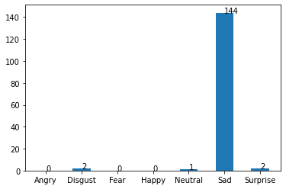
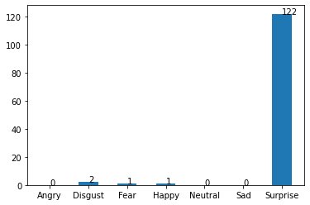
Sensitivity of the audio model
Sensitivity of the audio model w.r.t. Sad Emotion
Sensitivity of the audio model w.r.t. Surprise Emotion

Slide 17
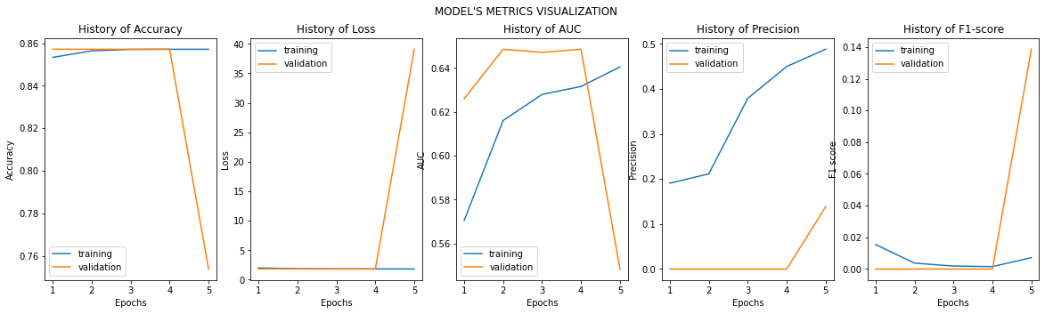
Results (Video Model)

Slide 18
Results
Show results
Include all figures that are relevant
All figures must be EXPLANATORY i.e., without clutter, focusing audience’s attention and include annotations

Slide 19
Conclusions
In past few week, we have analyzed alpha models and made some changes to them so that the we can increase the accuracy of the model.
We have then changed working of the audio model from just predicting emotion from English language to predicting emotions from Multiple languages.
We have then created a API to deployed the models that we have trained on the Webpage that can be then used by CogniXR.

Slide 20
Future work
Live therapy session prediction.
Collecting more multilingual audio data and training the audio model on the same.

Slide 21
Demo
Show a demo of your product [Dashboard/App]

